Slide 1
Polymorphism!
CS 201, Summer 2013

Slide 2
ADDITIONAL READING
Polymorphism
  Chapter 15 of Pearson book
  http://www.cplusplus.com/doc/tutorial/polymorphism/
  http://www.cs.bu.edu/teaching/cpp/polymorphism/intro/
  http://www.tutorialspoint.com/cplusplus/cpp_polymorphism.htm

Slide 3
Polymorphism
Polymorphism is a technique we can use with pointers and classes to handle a group of related classes the same way, even though there may be children we're handling.
In other words, identifying a Child class as its Parent class in order to generically access members shared between them both.

Slide 4
Polymorphism
We can create a pointer to a Base class, but point it to a Child of the Base class.
  This lets us access the members of Child that are shared with Base.
  Cannot access members specific to Child.
Button
Pointer to Button type can
ImageButton inherits from Button
Button* ptrButton
Image
Button
point to parent or descendants

Slide 5
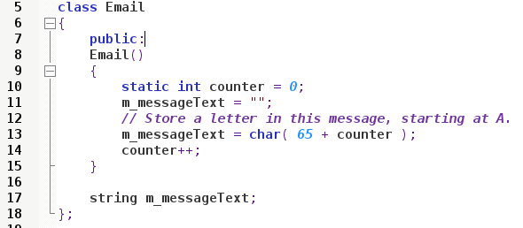
Polymorphism
Generic Email implementation

Slide 6
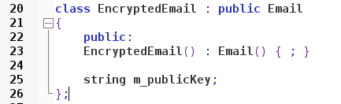
Polymorphism
Child “Encrypted Email” specialization

Slide 7
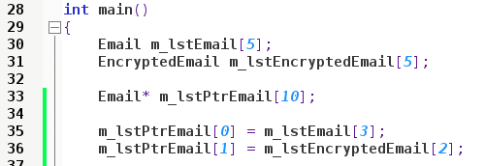
Polymorphism
Can create a pointer to Email parent,
and point to both Email and EncryptedEmail.

Slide 8
Polymorphism
We can then call any members that are shared
Cannot call special “Encrypted Email” functions without casting the pointer back to an “EncryptedEmail” type.

Slide 9
Polymorphism
Why use Polymorphism?
Create a generic “Interface” for something, then create implementations for specializations
FileSystem Item
string Label
Open()
Delete()
Folder
File
Shortcut

Slide 10
Polymorphism
We can overwrite the functionality in the child classes, so each item can use “Open()” differently.
FileSystem Item
string Label
Open()
Delete()
Folder
File
Shortcut

Slide 11
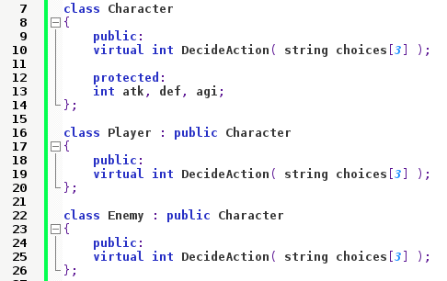
Virtual Functions
If we want to override a function in the child class, we need to declare the function as virtual.

Slide 12

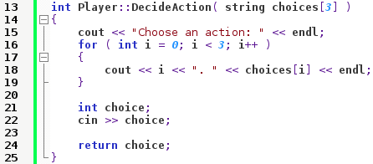

Virtual Functions
Then we can define the function for each class...
Different behaviors – If it's the Player class, we ask the user for input.
Otherwise, we randomly generate a choice for the Enemy.

Slide 13
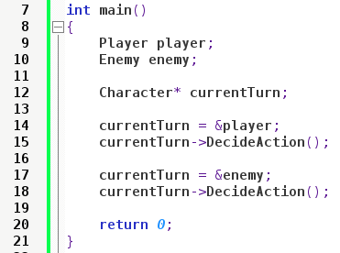
Virtual Functions
Now we can use a Character* pointer to point to either the player or enemy, then use the same interface for each.
This might seem like overkill for just one player and one enemy, but what about a game with lots of characters in the level?

Slide 14
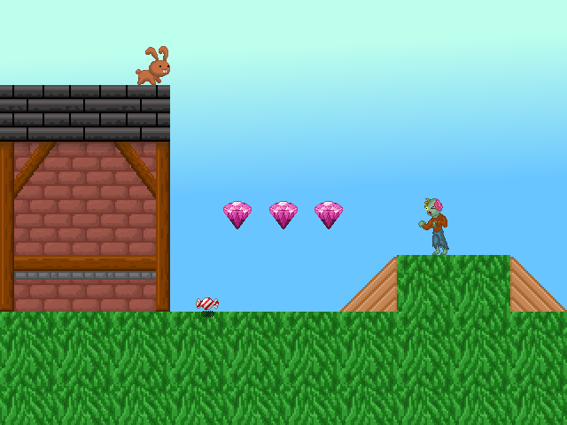
Virtual Functions
Player.Draw()
Item.Draw()
NPC.Draw()

Slide 15
Virtual Functions
You can store an array of pointers to some generic “Entity” object, which Player, Enemy, and Item inherit from.
Then, you can use a for-loop to iterate through everybody and use the generic Draw() function.

Slide 16
Pure Virtual Functions and Abstract Base Classes
You can also make the Base class Abstract.
When you have an Abstract class, you cannot create an instantiation of that class.
  This means you cannot declare a variable of this data-type (the class).
Why would you want an “unusable” class?

Slide 17
Pure Virtual Functions and Abstract Base Classes
Interfaces
  Previous examples of inheritance had, say, a “Button” and an “ImageButton”, both of which were usable.
  Maybe we just want to declare what features a “Button” object has, but we want to leave it up to the children to decide how to implement these.
  The Abstract Base “Button” class would act as an Interface for how we can use a Button.

Slide 18
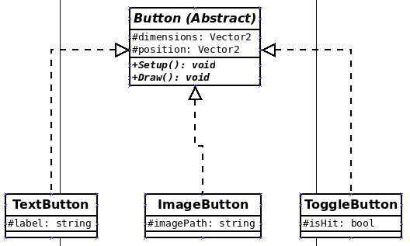
Pure Virtual Functions and Abstract Base Classes
You cannot have just a “Button” type, but every descendant Button will have the same Interface that a user-programmer can use.

Slide 19
Pure Virtual Functions and Abstract Base Classes
We can create an Abstract Base Class by using Pure Virtual Functions.
We use Virtual functions to make a class overridable, but we use Pure Virtual functions to ensure that descendants must override it.

Slide 20
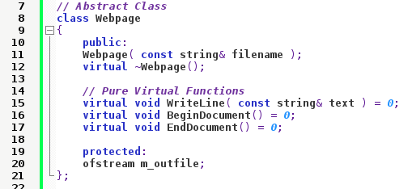
Abstract Base Classes
To make an Abstract Base Class, you need to have some pure virtual functions declared.
Pure
Virtual
Functions

Slide 21
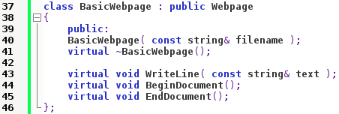
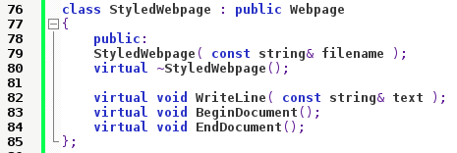
Abstract Base Classes
Then we can make classes that are specialized versions of a Webpage.
BasicWebpage and StyledWebpage may handle their
WriteLine(),
BeginDocument(),
or EndDocument()
functions differently.

Slide 22
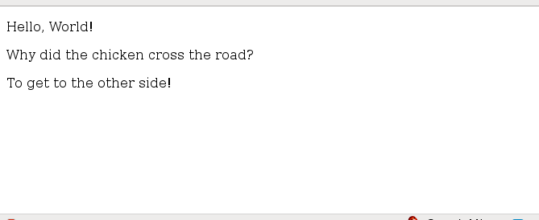
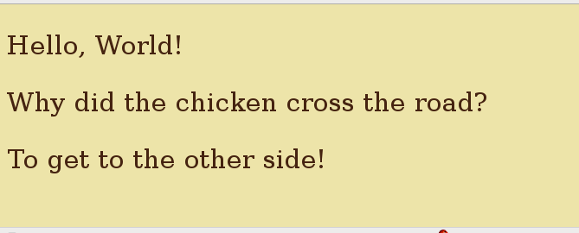
Abstract Base Classes
Basic Webpage and
Styled Webpage implementations

Slide 23
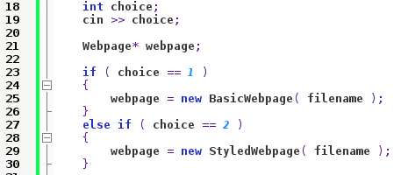
Abstract Base Classes
We can create a pointer to the Abstract Base Class, but point to a BasicWebpage or StyledWebpage...
Base Pointer
Specific Implementation

Slide 24
References

